Slide 1


Global Citizenship Alliance
Empowering the Next Generation of Global Citizens
Reza Fakhari, Ph.D.
President & CEO

Slide 2
Agenda
Introduction
  Who Are We
  Our Mission and Goals
  Why We Exist
  What We Offer
  When, Where & For Whom
Our Seminars
Our Impact
  Impact on Students
  Impact on Faculty
  Impact on Institutions
2026 Seminar Calendar & Cost
Partner with Us
Questions & Discussion
Thank You & Contact Info

Slide 3
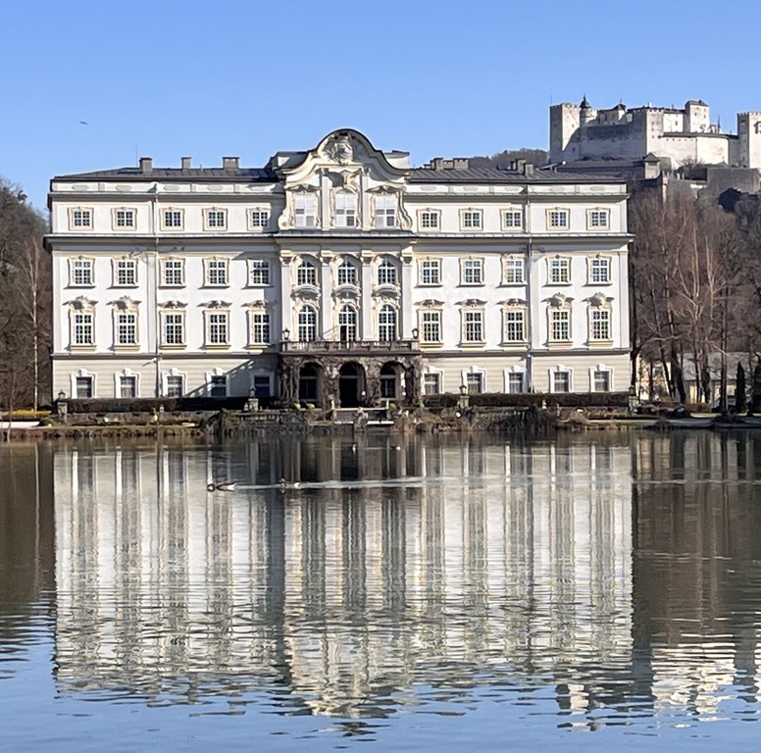
Introduction: Who we are
Global Citizenship Alliance (GCA) was founded in 2015 as a non-profit in the U.S. Recognized as a legal entity in Austria.
Origin goes back to 2004 when it was a program of the world-renowned Salzburg Global Seminar. Our affiliation continues.
Began with input and support from U.S. community college leaders.
Responding to the need of community colleges for short-term international experiences for students.
Immediate interest emerged from all types of institutions.

Slide 4
Who we are
4,500+ participants from nearly 100 institutions in 105 global citizenship seminars over the past 21 years.
80% student participants, with about 75% from community colleges. The remaining 20% were faculty and administrators.
Partnered with institutions to integrate global citizenship into curriculum, co-curriculum, and strategic plans, enhancing campus global engagement, and preparing students for work, life, and citizenship in the 21st century.

Slide 5
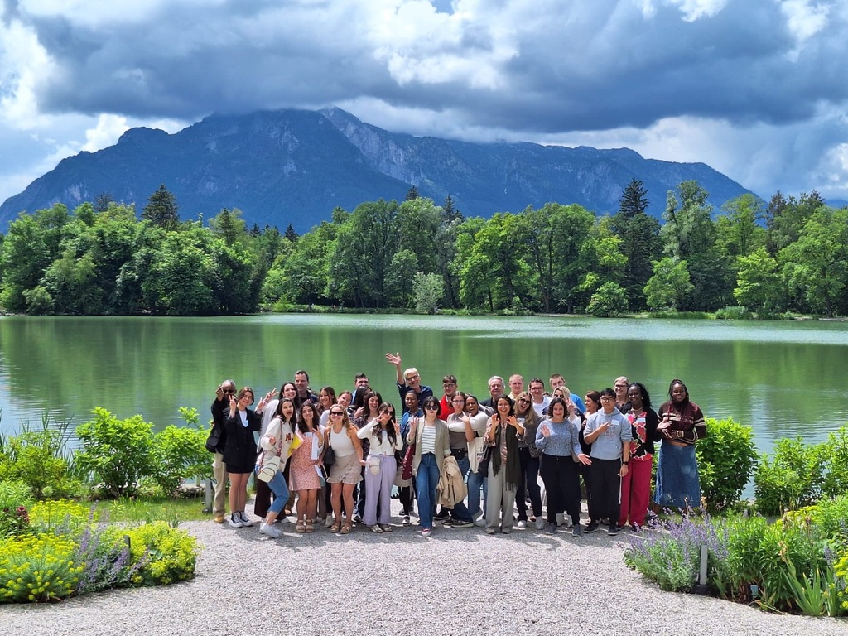
Our Mission and Goals
GCA is committed to promoting education for engaged knowledge and responsible action in an interdependent world.
We partner with colleges to empower students who:
Understand their role in a globally interconnected society and how local actions influence global outcomes, and vice versa.
Possess a critical understanding of the global issues and challenges facing humanity and the planet.
Are equipped with the knowledge, attitudes, values, skills, capacities, and empathy to engage with global systems in ways that foster justice, inclusion, pluralism, and ethical leadership.
Develop the ability to collaborate across cultures and engage in civil and civic discourse across differences.
Are inspired and empowered to make a positive impact in their overlapping local, national, and global communities.

Slide 6

Why we exist
Never have the lives of people been more interconnected and interdependent than today.
The challenges we face—global inequality, climate change, heath crises, migration, human rights violations, and the responsible development of AI—demand coordinated global responses.
Yet most youth feel unprepared to address global challenges, and a significant gap exists in education systems regarding global citizenship education. (WEF)
And as Employers increasingly value global perspective and competencies (AAC&U), the need for global citizenship education has never been clearer.
GCA fills this gap through one of the most comprehensive and inclusive global citizenship programs in the U.S.

Slide 7
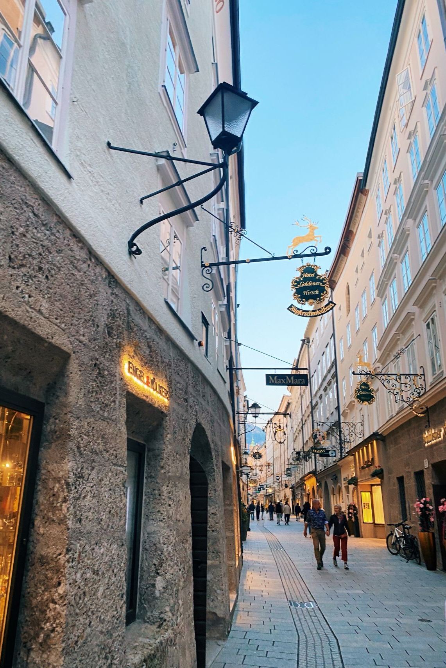
What we offer
Intensive, immersive, week-long residential global citizenship seminars held in historically and culturally rich European settings provide a unique, high impact international experience.
Engaging discussions led by expert faculty from various sectors, complemented by site visits to museums, cultural landmarks, and institutions of historical significance (e.g., Concentration Camp Memorial Site)
An academic framework that encourages participants from various majors to contextualize their own studies and career aspirations within a broader, international setting.
Networking opportunities with peers and professionals from diverse backgrounds.
Access and engagement with faculty who have developed a deep subject expertise in global citizenship education, both in general and in strategic approaches to making it an institutional reality.

Slide 8
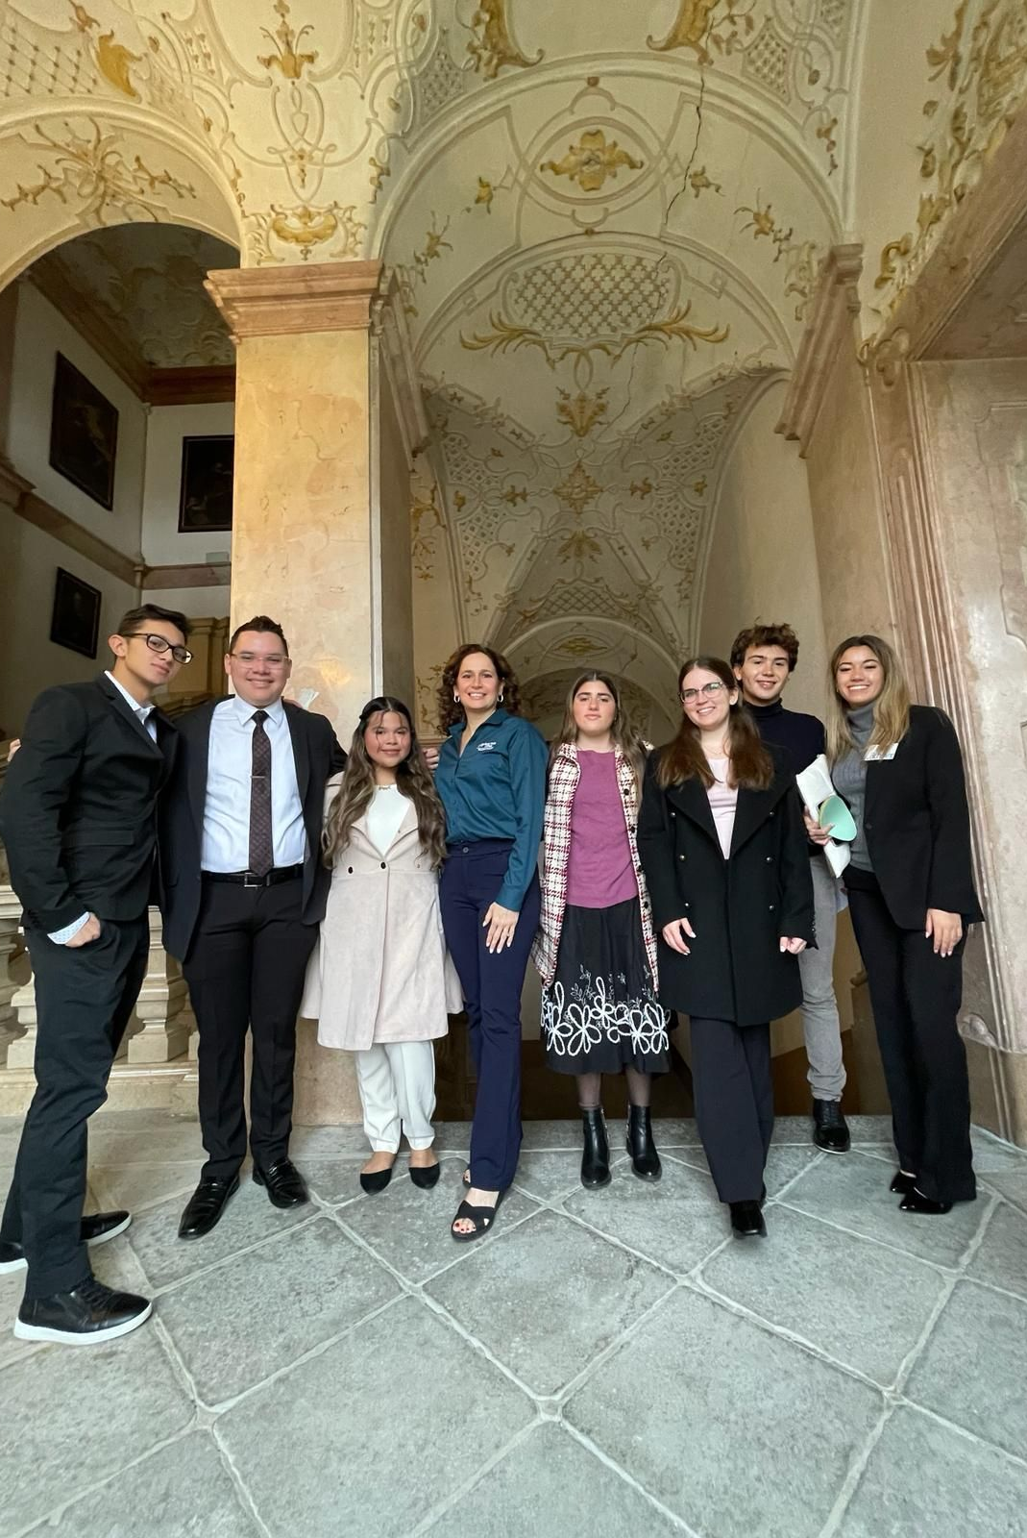
When, Where & for whom
Seminars are typically scheduled during academic breaks (winter, spring, or summer) to accommodate student and faculty availability.
Seminars are primarily held at the historic Schloss Leopoldskron, the iconic campus of Salzburg Global Seminar.
Programs primarily target community college students at various stages in their educational journey and faculty eager to incorporate global citizenship themes into their teaching.
Institutions select and send a cohort of students, accompanied by faculty advisor(s) to the Student Sessions.
Colleges also send a cohort of faculty and staff to the Faculty & Administrators Session, usually held in July.

Slide 9
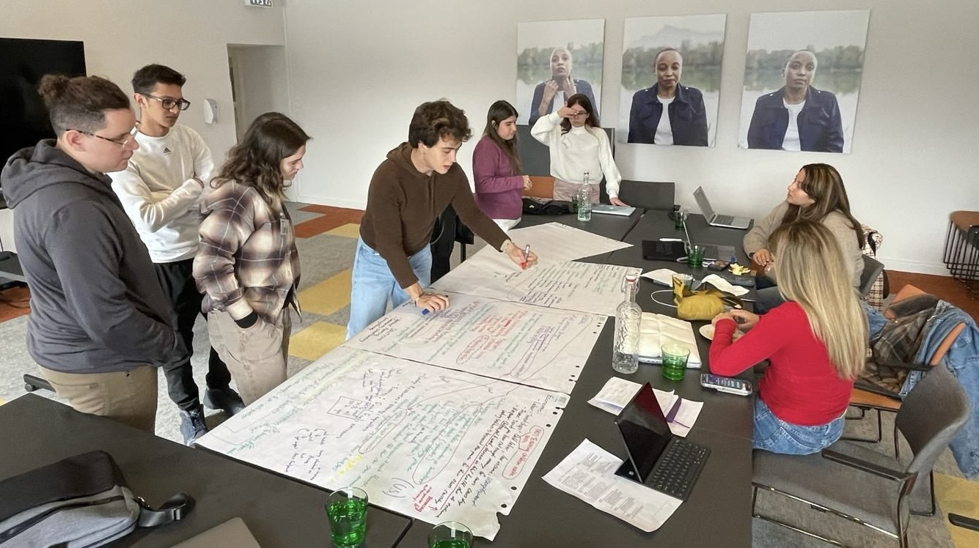
Our seminars
Our integrative global learning seminars are project-based and peer-learning focused, covering themes like democracy, human rights, globalization, climate change, sustainability, migration, global inequality, soft power, conflict and peace, technological change, and ethical leadership, and providing a cohesive framework for exploring global citizenship and its practical, real-world applications.
Student learning outcomes include:
    Understand globalization and its global impacts—both positive and negative—and its transformation of society.
    Examine the reality that interdependence is no longer a choice, but a prevailing condition.
    Appreciate human diversity and engage with various groups to address shared challenges.
    Recognize critical global issues threatening humanity’s future and the complexity of their interconnected solutions.
    Collaborate across diverse stakeholders, thinking globally and acting locally, to foster a more sustainable and equitable world.

Slide 10
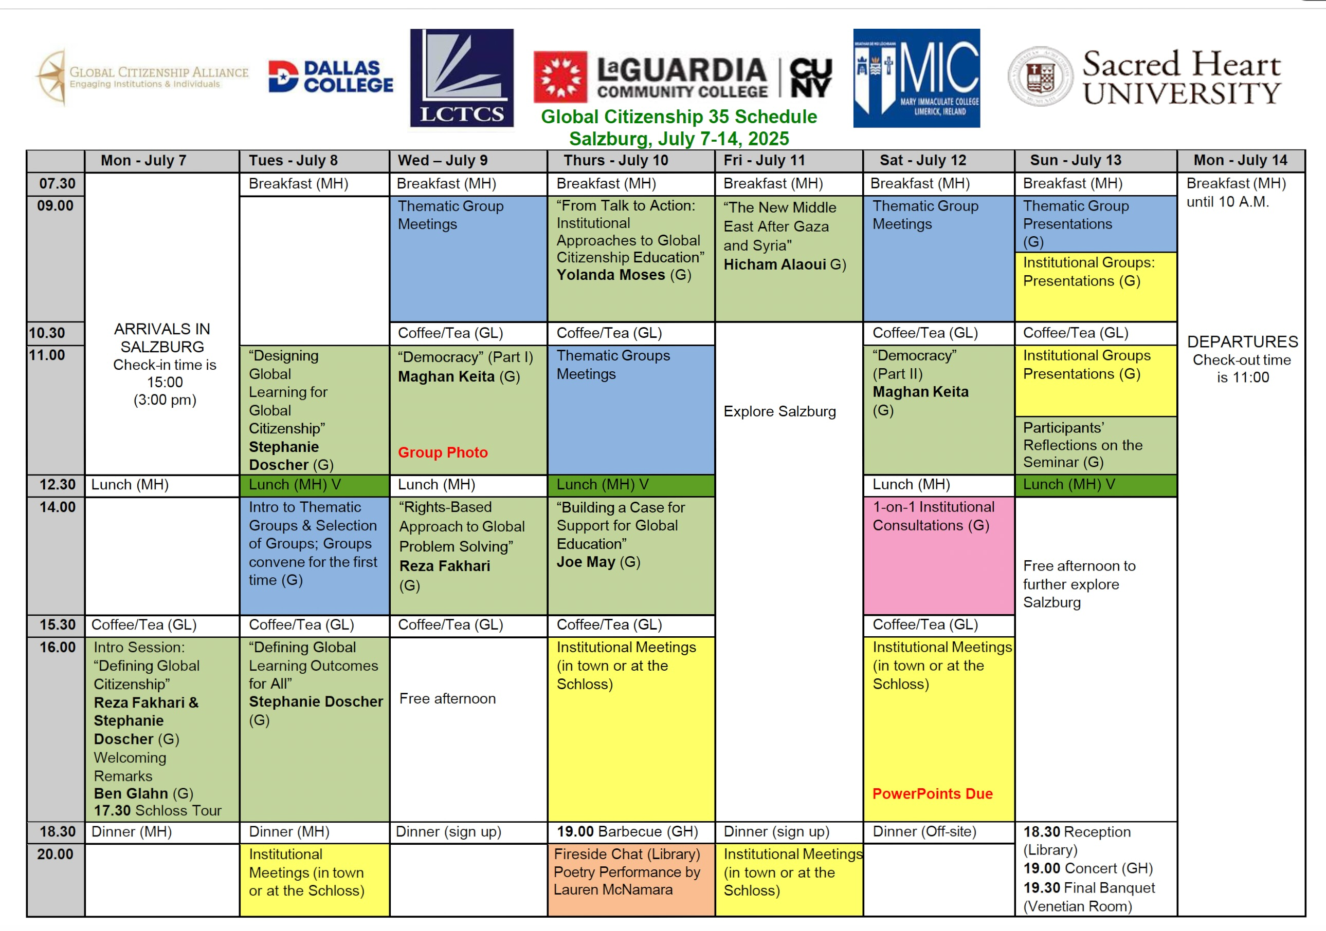

Slide 11
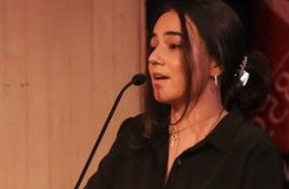
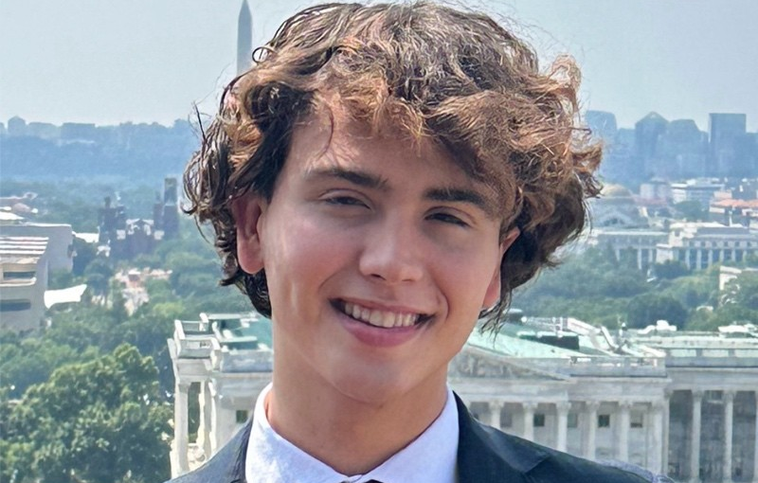
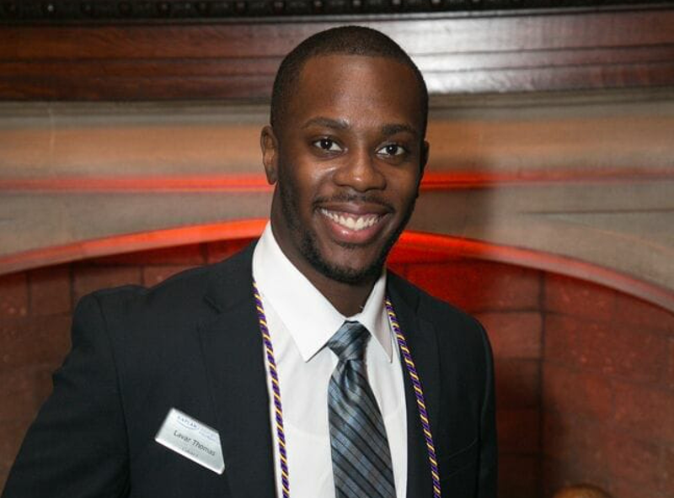
Impact on students
  Students describe the experience as transformative: they return inspired to pursue further education and career choices with civic and global impact
  Herta Hada, St. Francis College, 2023. International law intern. “This immersive Seminar provided profound insights into the complexities of global challenges and inspired collaborative solutions that resonate with the Seminar’s theme of thinking globally and acting locally. Experiences like these reaffirm my commitment to making a positive impact on a global scale.”
  Arquimedes Rivero, Miami Dade College, 2024. BA student at Georgetown University School of Foreign Service. “Attending the Global Citizenship Alliance's Salzburg Seminar was among the most transformative experiences I have had during my time at MDC, and my young adult life.
  Lavar Thomas, Kingsborough Community College, 2010. Leadership coach and co-founder of Leaders of Tomorrow: “Salzburg influenced my decision to pursue a career in public service and my commitment to developing the next generation of global citizens.”

Slide 12
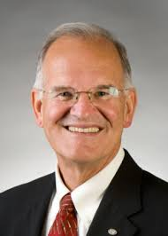
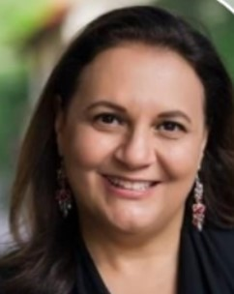
Impact on faculty
Participating faculty and administrators have returned to their institutions with a new sense of purpose and new insights on incorporating global perspectives into their teaching and leadership practices.
Walter Gmelch, Faculty, University of San Francisco: “Through student evaluations, interviews, and personal interactions, we have been amazed how this short-term GCA program has made a significant impact. One of the dominant themes students valued was the way ‘seminar faculty were approachable between sessions, over coffee breaks, and having meals together.’ This opportunity seldom is part of the student-faculty experience back on our home campuses.”
Noeli Piccoli Biggs, Senior Manager of Academic Programs, Dallas College: “Participating in the 2024 Seminar has been a transformative experience that has significantly shaped my worldview. I am eager to infuse Global Citizenship elements into the Service-Learning Program for local and global impact at my college.”

Slide 13

Impact on institutions
Colleges become more attractive to prospective students seeking education beyond the classroom.
Committing to comprehensive, worldwide learning opportunities appeals to donors, industry partners, and community stakeholders.
A more globally aware campus community aligns with workforce development goals, ensuring graduates are prepared to meet the demands of today’s diverse economy shaped by globalization.
GCA’s influence is evident in the national recognitions that many partner institutions have received for their work in global citizenship education.

Slide 14
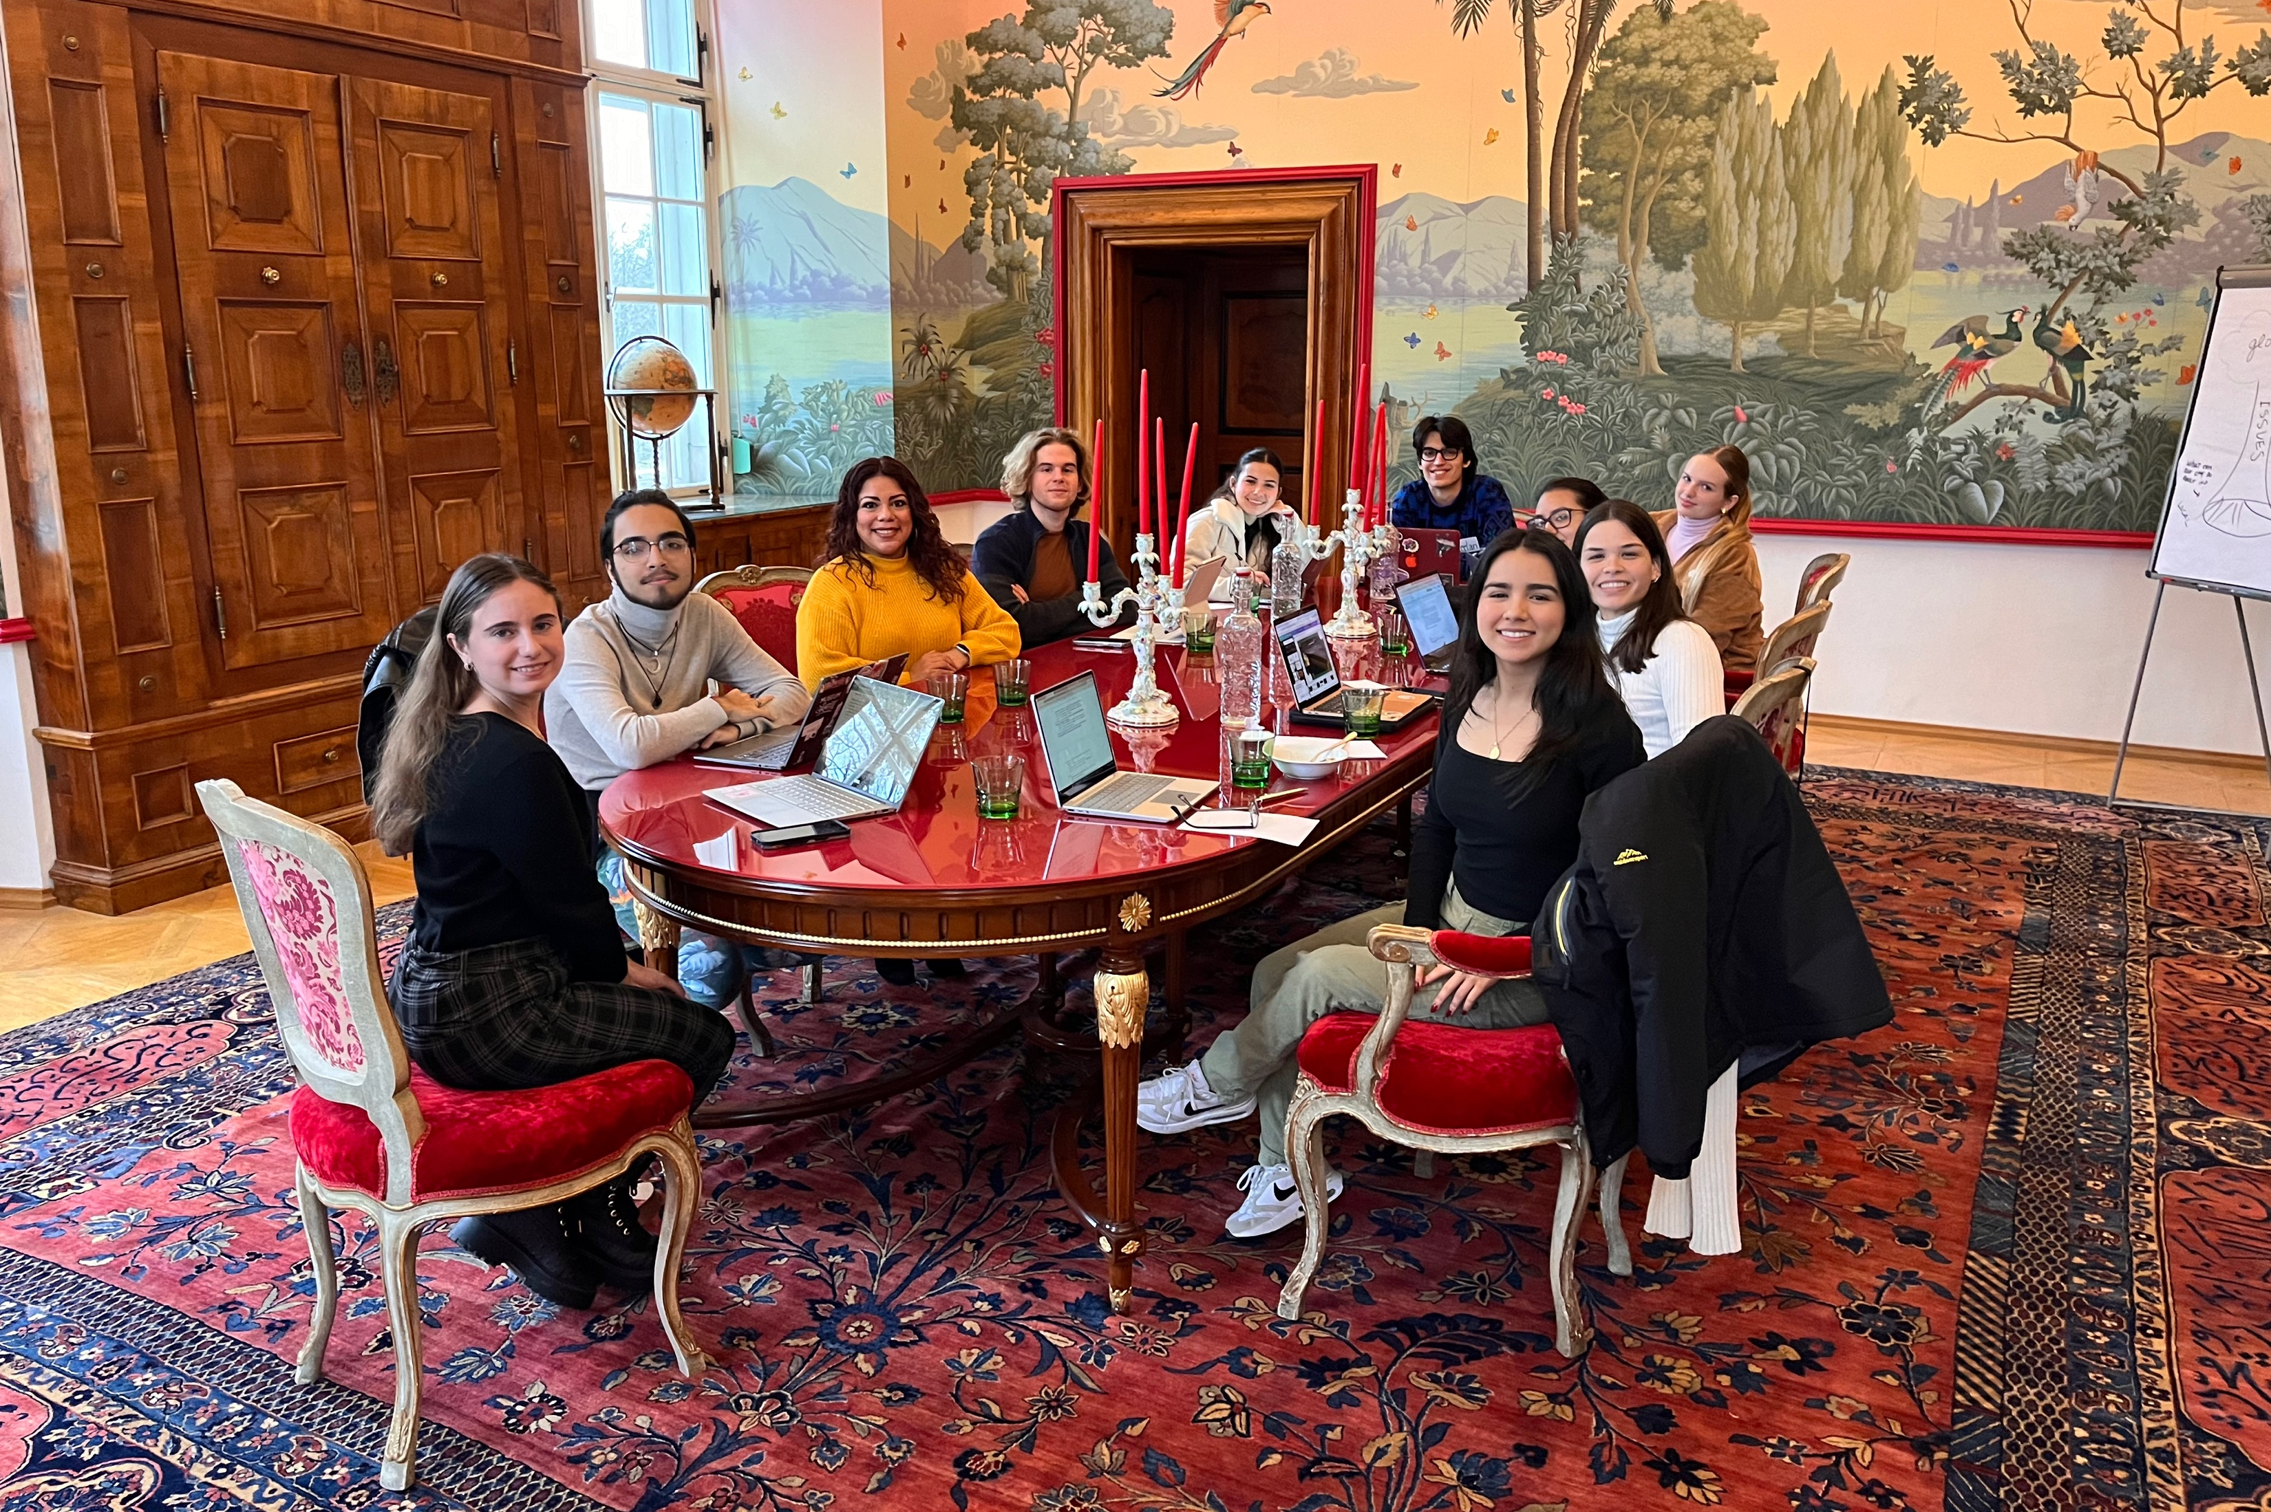
2026 Calendar & Cost
  Seminars for Students:
    GC Seminar 36: Feb. 20-27
    GC Seminar 37: April 3-10
    GC Seminar 38: May 23-30
    GC Seminar 39: June 2-9
  Seminars for Faculty & Administrators:
    GC Seminar 40: July 13-20
  Cost:*
    $2,450 per person for Student Seminars
    $2,450 per faculty advisor accompanying a student group
    $3,250 per person for Faculty & Administrators Seminars
    Due to Dollar decline against Euro by about 10%, an additional charge for currency fluctuation may be assessed since al our operations are charged in Euros in Austria.
    *Costs cover all program fees, full room & board, and sponsored activities or field trips. Airfare is not included.

Slide 15

Partner with us
Affordable, impactful international experiences for community college students, faculty, and administrators.
Carefully designed interdisciplinary seminars for all majors that provide deep global learning and emphasize the importance of civil discourse and democratic engagement.
Investing in these opportunities helps institutions shape graduates who are well-prepared to be engaged global citizens and future leaders.
Participation is based on a contractual agreement to send students to Student Seminars (with faculty chaperones) and/or faculty to Faculty & Administrators Seminars.
Seminar offerings can be flexible timewise and can be tailored to specific institutional needs.

Slide 16
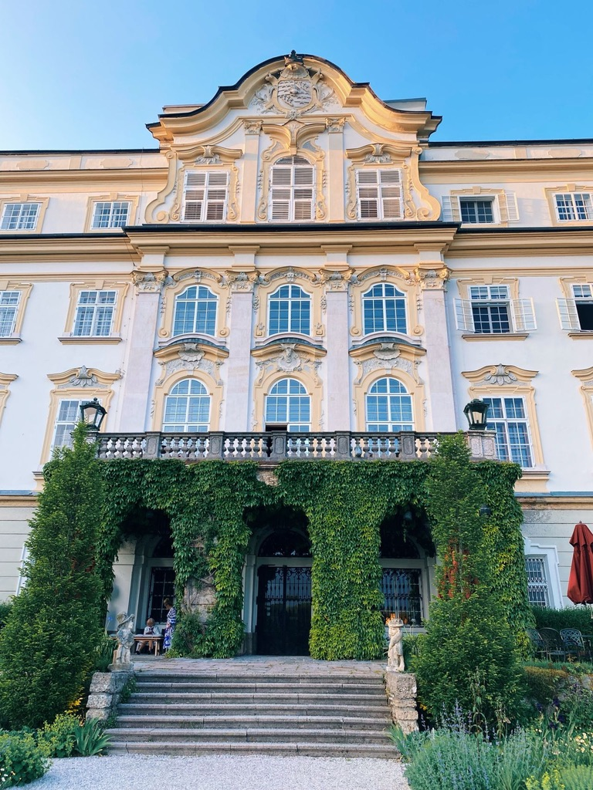
Questions & Discussion

Slide 17

Thank You & Contact information
Reza Fakhari
President & CEO
rfakhari@GlobalCitizenshipAlliance.org
Mobile: (917) 960-0310
www.GlobalCitizenshipAlliance.org

